Slide 1

2016 Full Year Results
March 2017

Slide 2
Disclaimer
NOT FOR PUBLICATION OR DISTRIBUTION, DIRECTLY OR INDIRECTLY, IN OR INTO THE UNITED STATES
This presentation has been prepared and issued by Bank of South Pacific Limited (the “Company”), and may not be reproduced in whole or in part, nor may any of its contents be disclosed to any other person without the prior written consent of the Company.
This presentation is provided by the Company for general information purposes only, without taking into account any recipient’s personal objectives, financial situation or needs. It should not form the basis of or be relied on by the recipient in considering the merits of any particular transaction and does not purport to contain all of the information that an interested party may desire. It is not an offer to buy or sell, or a solicitation to invest in or refrain from investing in, any securities or other investment product. This presentation has not been filed, lodged, registered, reviewed or approved by any regulatory authority in any jurisdiction and recipients of this presentation should keep themselves informed of, and comply with and observe, all applicable legal and regulatory requirements. The distribution of this presentation in certain jurisdictions may be restricted by law and, accordingly, recipients of this presentation represent that they are able to receive this presentation without contravention of any unfulfilled registration requirements or other legal restrictions in the jurisdiction in which they reside or conduct business. Nothing in this presentation constitutes investment, legal, tax, accounting or other advice. The recipient should consider its own financial situation, objectives and needs, and conduct its own independent investigation and assessments of the contents of this presentation, including obtaining investment, legal, tax, accounting and other advice as it considers necessary or appropriate. Any costs incurred by recipients in making such investigations and assessments, etc. are not the responsibility of the Company or any of its advisers, directors, employees or agents.
Provision of this presentation is not a representation to any recipient or any other person that the shares or business of the Company or any of its subsidiaries will be sold. The Company may at any time negotiate with one or more interested parties and enter into a definitive agreement without prior notice to any or all interested parties. The Company also reserves the right to terminate, at any time, further participation in the investigation and proposed process by any party, to modify any of the rules or procedures set forth herein or any other procedures without prior notice or assigning any reason therefore or to terminate the process contemplated hereby. The Company reserves the right to take any action, whether in or out of the ordinary course of business, which the Company in its sole discretion deems necessary or prudent in the conduct of its business or the process contemplated by this presentation.
This presentation has been prepared on the basis of publicly available information and/or selected information and does not purport to be all-inclusive or to contain all of the information that may be relevant to the presentation. Neither the delivery or supply of this presentation (or any part thereof) nor the provision of information referred to herein or provided in connection with the evaluation of the Company by interested parties shall, under any circumstances, (a) constitute a representation or give rise to any implication, that there has been no change in the affairs, business or financial position of the Company or any of its subsidiaries, associated companies or affiliates or in the information herein since the date hereof or the date on which this presentation has been provided or delivered or (b) provide a basis of any credit or other evaluations and should not be considered as a recommendation by the Company that any recipient of the presentation or such other document or information contemplated herein should proceed with a further investigation of the Company or enter into any transaction with the Company or any person in relation to the Company. Neither the Company nor any other person are under any obligation to update or correct this presentation.
The Company and its related bodies corporate and other affiliates, and their respective officers, employees, advisors, representatives, consultants and agents (“Relevant Parties”) make no representation or warranty, expressed or implied, as to, and no reliance should be placed on, the fairness, accuracy, completeness, timeliness or reliability of the contents of this presentation or any other written or oral communication transmitted or made available to any interested party, whether as to the past or future. To the maximum extent permitted by law, none of the Relevant Parties accept any liability (including, without limitation, any liability arising from fault of negligence on the part of any of them) for any loss whatsoever arising from the use of this presentation or its contents or otherwise arising in connection with it or as a result of any omission, inadequacy or inaccuracy herein. Only those representations and warranties that are provided in a definitive agreement when, and if, it is executed, and subject to such limitations as may be provided in such agreement shall have any legal effect. This presentation may contain forward-looking statements, forecasts, estimates and projections (“Forward Statements”). No independent third party has reviewed the reasonableness of any such statements or assumptions. None of the Relevant Parties represents or warrants that such Forward Statements will be achieved or will prove to be correct. Actual future results and operations are subject to significant business, economic and competitive uncertainties and contingencies, many of which are beyond the control of the Company, and could vary materially from the Forward Statements. Similarly, no representation or warranty is made that the assumptions on which the Forward Statements are based may be reasonable. No audit, review or verification has been undertaken by an independent third party of the assumptions, data, historical results, calculations and forecasts presented. In receiving this presentation, each recipient acknowledges that it shall not deal or cause or procure any person to purchase, acquire, dispose of or deal in any securities of the Company in breach of any laws and regulations relating to insider dealing, market abuse or securities in general of Singapore and elsewhere.
The recipient acknowledges that no person is intended to act or be responsible as a fiduciary to the recipient, its management, stockholders, creditors or any other person.
By accepting and providing this presentation, the recipient expressly disclaims any fiduciary relationship with any person and agrees that the recipient is responsible for making
its own independent judgements with respect to any transaction and any other matters regarding this presentation.
The Company is not authorised under the Banking Act 1959 (Cth) (the "Banking Act") and is not supervised by the Australian Prudential Regulation Authority. The Company's products are not covered by the depositor protection provisions in section 13A of the Banking Act and will not be covered by the financial claims scheme under Division 2AA of the Banking Act.
2
2

Slide 3

Highlights for 2016
Profit (NPAT) up 21% to K643.5m
Cost to Income ratio improves to 42.9%
Capital Adequacy maintained at 23.1%, exceeds BPNG requirement of 12%
Total Income up 16% to K1.79bn
Total Assets up 14.5% to K20.8bn
Loan Provisions maintained at 4.9%
Dividend Yield of 9.8%
ROE up 1.8% to 29.6%
Group NPAT (PGK ‘m)
CAGR 12.1%
Sub - title of Presentation
Slide 1
3

Slide 4
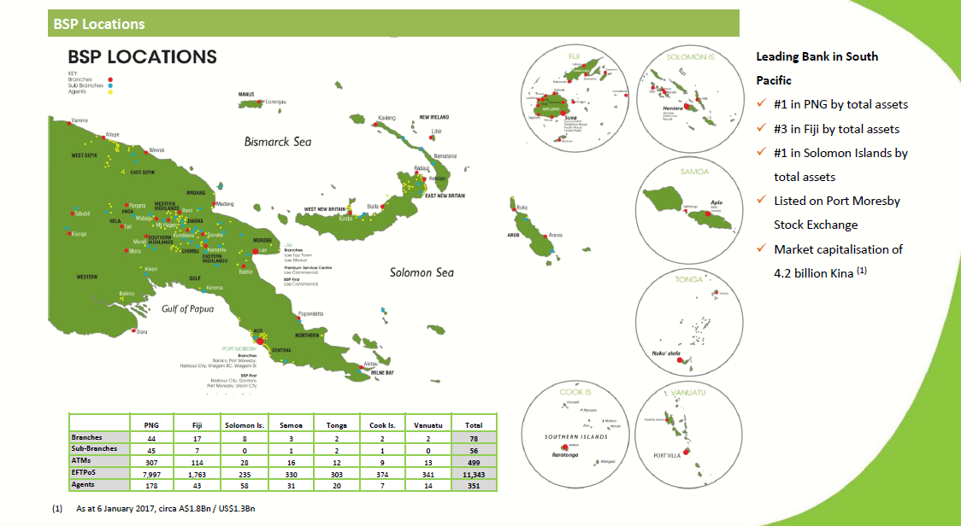
BSP’s Geographical footprint
#2 in Fiji by total assets
Sub - title of Presentation
Slide 1
4

Slide 5
Profit contribution by business
Sub - title of Presentation
Slide 1
5

Slide 6
Asset growth by business
Sub - title of Presentation
Slide 1
6

Slide 7
Market Strength
Loans market share
Deposits market share
39%
PNG 55%
Fiji 22%
Sol Isl 46%
Samoa 22%
Cook Isl 34%
Tonga 39%
Vanuatu 12%
43%
PNG 57%
Fiji 24%
Sol Isl 56%
Samoa 23%
Cook Isl 69%
Tonga 37%
Vanuatu 13%
Sub - title of Presentation
Slide 1
7

Slide 8
Asset Growth (K’m)
Total Assets 14.5%
Loans
17.2%
Investment 8.9%
Sub - title of Presentation
Slide 1
8

Slide 9
Loans and Deposit growth
Sub - title of Presentation
Slide 1
9

Slide 10
Income Stream Increases (K’m)
10%
17%
42%
33%
16%
Sub - title of Presentation
Slide 1
10

Slide 11
Expenses scaling with growth (K’m)
17%
47%
54%
11%
Cost to Income
33%
23%
44.7%
42.9%
Sub - title of Presentation
Slide 1
11

Slide 12
Financial Ratios
Sub - title of Presentation
Slide 1
12

Slide 13
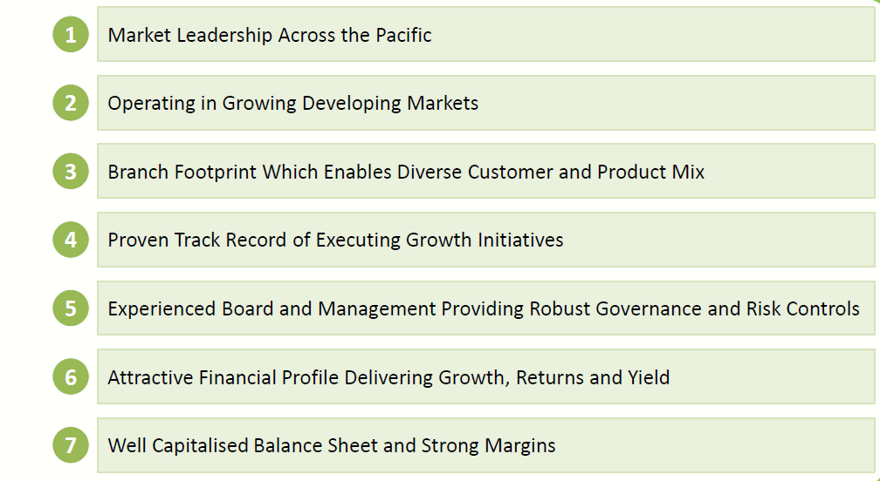
BSP Key Strengths
Sub - title of Presentation
Slide 1
13

Slide 14
Business Position - Strategy
Cement domestic leadership position
    Grow corporate loan portfolio within specific products and industry sectors in alignment with economic activity, and facilitate medium to long term relationships with customers
    Continue to develop workforce through:
      Preparing, training, nurturing and developing the capacity and skills of in-country and regional corporate leadership
      Enhancing depth to match business line and regional growth plans
    Increase customer satisfaction through continually upgrading sales and customer service skills of employees to adapt to a competitive environment
    Promote customer take up of BSP’s extensive branch and e-channel network
Pacific Islands
Broaden product footprint
    Develop capabilities in new product segments, including:
      Pursue opportunities for asset finance in all markets where BSP operates
      Refreshing capabilities of existing e-products and introducing products which address the evolving needs of customers
    Implement a new Core Banking solution to provide a common and up-to-date operating platform for the bank across the region, and realise efficiencies with a lower Total Cost of Ownership
Insurance
    Develop a model in all countries BSP operates for an increased profile of BSP Life
    Evaluate longer term potential for general insurance offering
Growth acquisitions in Pacific and Southeast Asia Region
    Further consolidate leading market position in existing and new Pacific markets
    Establish footprint in South East Asia via an asset finance joint venture (Initially in Cambodia )
Regional
14

Slide 15
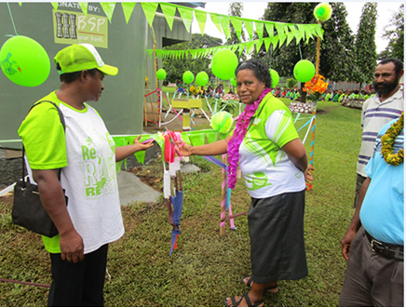

BSP in the community
Community Projects
BSP is actively involved and has contributed over K6.7m in community projects around the country since 2009.
2016
K1.15m in PNG
~K250k Non PNG
Sponsorships
BSP also contributes immensely through sponsorship of various events in the country totalling K2.3m in cash in 2016
Sports and cultural events K1m
Conferences K420k
Corporate Events K870k
Sub - title of Presentation
Slide 1
15

Slide 16
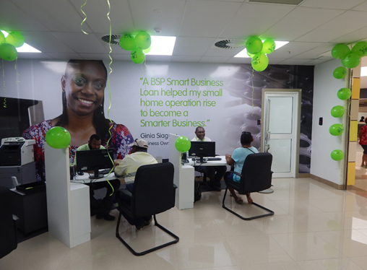
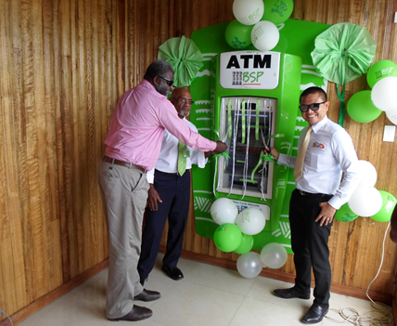
BSP Focus
SME Lending Centres
BSP MSME has grown over the years providing SMART business solutions and start up kits to our customers.
Customers
Loans
Deposits
~26k
K28m
K396m
ATM Network Rollout
BSP has the largest ATM/Eftpos network in PNG and is the first and only bank in PNG to introduce deposit taking ATM’s
36.5m ATM Transactions in PNG
499 ATM’s across the region
ATM allows mobile top up and cash deposit
Sub - title of Presentation
Slide 1
16

Slide 17
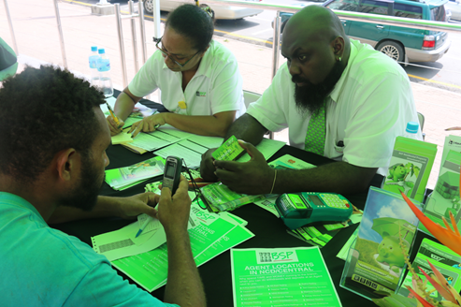
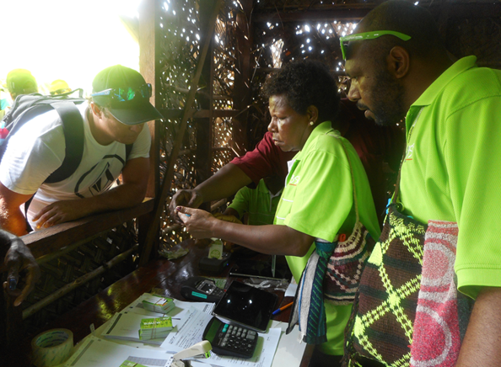
BSP…technology for inclusion
Growing Deposits through Technology
BSP signs up new customers everyday using state of the art technology to grow its customer base
~2.1m deposit accounts (region)
~110m transactions annually (PNG)
Average balance of ~K2k
Agencies and Sub branches
In PNG and in each country where it operates, BSP agents reach the unbanked in rural areas and provide access to basic banking services
Agencies
351 Agents across the region
Sub branches
56 Sub-branches across the region
Sub - title of Presentation
Slide 1
17

Slide 18
2016 Performance Summary
Balance Sheet Growth Loans growing from increased corporate and retail lending in PNG, strong growth in the loan portfolio across all other countries, and also includes the incremental impact of Vanuatu business acquisition A dominant market share in loans and deposits in PNG, and leading and/or significant market shares in other countries where BSP operates Income Increasing Loan growth generated higher net interest income, despite experiencing margin compression in PNG Fx income driven by increased turnover largely provided by additional export flows into PNG since April 2016 Income also increased showing the full year effect of acquisitions in Solomon Islands, Samoa, Tonga, Cook Islands, and half year from Vanuatu Expenses well contained Expenses increased but note this includes the impact of a full year of costs from acquisitions in Solomon Islands, Samoa, Tonga, Cook Islands, and half year from Vanuatu Overall, costs were well contained, with the cost to income ratio improving from a reduction of 1.8% to 42.9%, due to the benefits of ongoing cost reduction measures and improving scalability of the business A sound Balance Sheet The Capital base is sound and maintained at 23.1%, exceeding BPNG requirements, despite the impact of continuing growth in assets, as well as payment of dividends of K414m in 2016 (2013: K370m)
Sub - title of Presentation
Slide 1
18

Slide 19
Appendix
Investor Pack Q4/2016
Slide 1
Sub - title of Presentation
19

Slide 20
Quarterly Financial Ratios
Investor Pack Q4/2016
Slide 1
Sub - title of Presentation
20

Slide 21
Profit and Loss (K’m)
Group NPAT in Q4’16 is up 7% (+K11.4m) to K176.8m from K165.3m (Q3’16).
Total Revenue of K505m is up 11% in Q4’16 vs Q3’16. Net interest income increased by K15m driven by increases in interest on loans and interest on Government securities of K9.3m and K3.5m respectively
FX Income increased by K9.6m with large volumes of inflows facilitating outflow orders. Other income increased by K15.3m following the sale of Port Moresby Head Office which resulted in a net gain of K12m. Net insurance income increased by K9.7m mainly due to appreciation of investment properties and equities held by BSP Life.
Other Operating Expenses (less Dep’n) are K180.4m for Q4’16 representing a 3.4% increase over the previous quarter. Staff costs and other costs were well managed over the period, but Fixed Asset write offs increased by K8.9m following a review of useful lives of IT assets.
The Group’s Cost to Income ratio reduced from 43.5% in Q3’16 to 40.16% for Q4’16 as revenue increased and costs continued to be managed prudently.
Investor Pack Q4/2016
Slide 1
Sub - title of Presentation
21
Notes:
Although the bottom line reconciles to K643m, there are some slight variance in the following:
Net Interest income from prospectus of K1,107.7 vs K1,108.7 in investor pack.

Slide 22
Balance Sheet (K’bn)
Total Assets increased by 2% (+K371m) to K20.8b at end of Q4’16, compared to K20.4b in Q3’16. Loan growth in Q4’16 was K150m, 2% increase from Q3’16. PNG loan growth was K133m and other entities grew by K17m including some effect arising from Fx translation.
Growth in Other Interest Earning Assets was K134m, largely in PNG
Total deposits increased by 3.5% (+K577m) to K16.9b at Q4’16 with PNG increasing by K546m and other entities increasing by K31m including Fx translation.
Investor Pack Q4/2016
Slide 1
Sub - title of Presentation
22

Slide 23
Market Share - Loans
Commentary
BSP’s combined market share for loans rose to 39% in Q4’16, after the inclusion of BSP Vanuatu with its market share steady at 12% in Q’3
PNG loans increased by K160m in the quarter and market share remains steady at 55%.
BSP’s loan portfolio remains predominantly based in PNG, with PNG accounting for 67% of the group’s loan balances.
BSP Fiji also maintained its market share at 22%, and similarly BSP’s operations in other jurisdictions maintained market share, on average.
Investor Pack Q4/2016
Slide 1
Sub - title of Presentation
23

Slide 24
Market Share - Deposits
Commentary
BSP’s combined deposit market share stands at 43% in Q4’16.
BSP PNG deposits grew by 5% (K546m) in the quarter with a market share at 56% for the quarter. Fiji market share remain steady at 24%.
Deposits mix below saw an increase in both Demand and Term deposits by 3% and 6% respectively.
Sub - title of Presentation
Slide 1
Investor Pack Q4/2016
24

Slide 25
Financial Risk Management
Capital Adequacy
Provisions to Loans
Capital Adequacy ratio is at 23.1% in Q4’16, compared to 21.0% in Q3’16, still well in excess of the 12% prudential requirement.
BSP’s Provisions to Loans ratio increases by 0.1% to 4.9% at Dec’16, a similar position to Q4/15.
Investor Pack Q4/2016
Slide 1
Sub - title of Presentation
25

Slide 26
Share Price
K4.206bn market Cap
Share Price K9.00
30th Dec’16
Dividend Yield – 9.8% …compares favourably to top performing banks in comparable markets
PE Ratio – 6.5 times
Investor Pack Q4/2016
Slide 1
Sub - title of Presentation
26
Notes:
PE Ratio = Price per share/EPS
EPS= Net income – dividends on preffered stock /Average outstanding shares
= 643,451m/467,322m
= 1.38
PE = 9/1.38= 6.5 times
Dividend Yield = Annual Dividends/Price per share
= .88/9 * 100 = 9.8%

Slide 27
Thank You
Sub - title of Presentation
Slide 1
27

